Slide 1
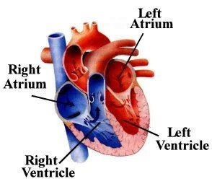
The Human Heart
Name:
Course Title:
Thursday, 10 December 2020
Instructor:

Slide 2
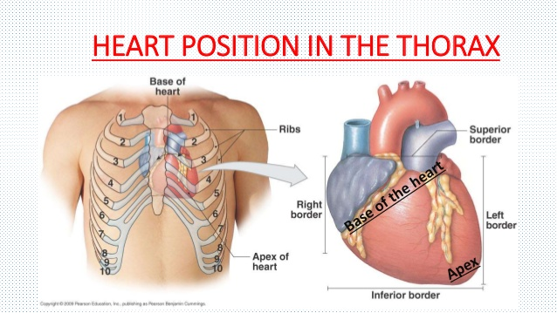
Heart Location
According to Anatomy of the Human Heart (2020),the heart is housed in the left side of the thoracic cavity between the two lungs and behind the left of the sternum which is also known as breastbone.
It is enclosed in pericardium, a double-layered sac.
The lowest part lies on the diaphragm.

Slide 3
Anatomy of the Heart
The heart is made up of tough muscles called Cardiac muscle also known as myocardium that does not tire.
It has four chambers. The upper are the atria while the lower are ventricles (Hoffman, 2009).
It has valves that regulates the flow of blood by preventing backflow.

Slide 4
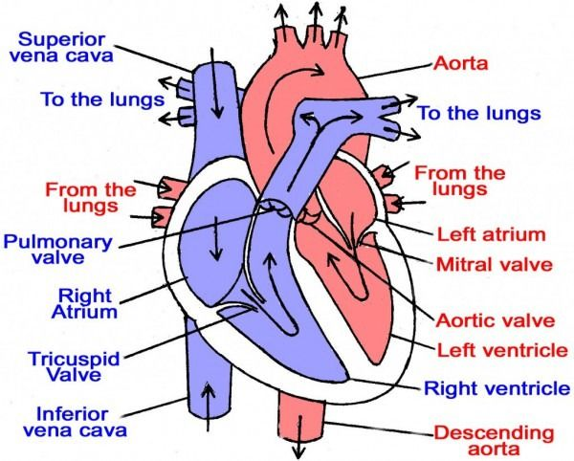
Chambers of the Heart
The right atrium gets the deoxygenated blood from all parts of the body through vein.
It then pumps the blood into the right ventricle
The right ventricle pumps the blood to the lungs
In the rungs, the blood is loaded with oxygen and pumped back into the left atrium
The oxygenated blood is then pumped into the left ventricle, which is the strongest chamber, where it is pumped back into the body.

Slide 5
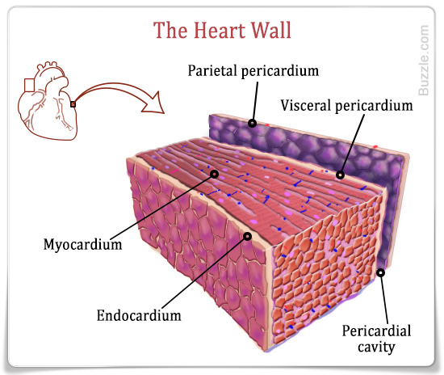
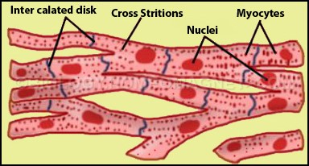
Types of cells and tissues in heart
The heart is made up of cardiac muscles
It is the only organ that has such tissue which ensure that it does not get tired.

Slide 6
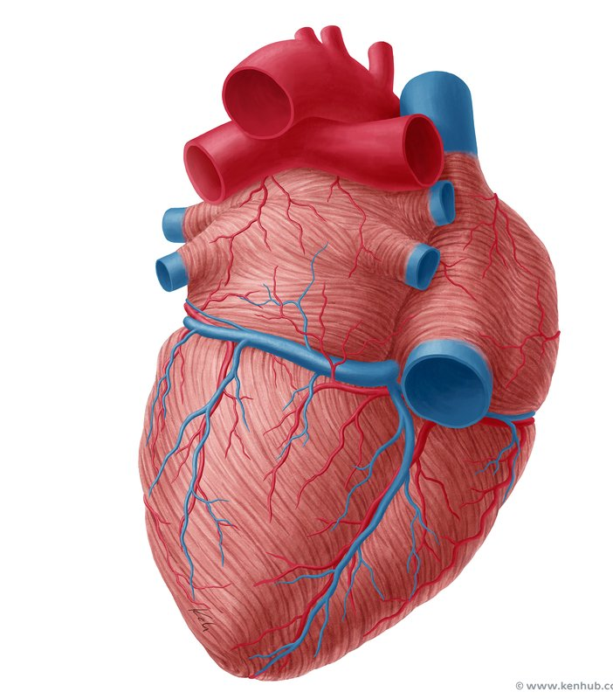
Nurves and Blood Vessels in the Heart
The heart is supplied with oxygenated blood by numerous network of coronary arteries.
The heart is also supplied with a network of nerve which govern relaxation and contracting of the heart tissues.
This nerve are the sympathetic and parasympathetic nurveous system (Hoffman, 2009).
Sympathetic speeds up the heart beat rate while parasympathetic slows it.
The two system are said to be antagonistic in nature since their fuction is an opposite of the other.

Slide 7
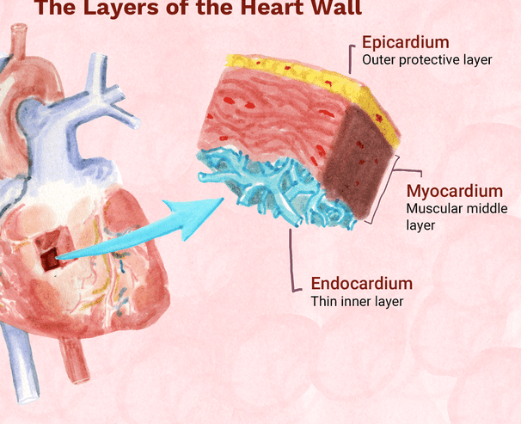
Heart Walls
The heart walls are made up of strong cardiac muscles.
They wall is made up of three layers
    Epicedium, (outer layer)
    Myocardium (middle layer)
    Endocardium (inner layer)
Both the Epicedium and Endocardium are slender, (Hoffman, 2009).
The Myocardium is very thick forming the bulk of the wall. It is made up of strong cardiac muscles

Slide 8
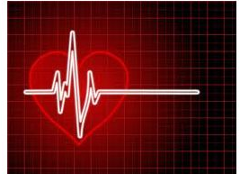
Functions of the Heart
Heart is the organ that pumps blood into all body parts (Morita, Seidman, & Seidman 2005).
This enable all parts of the body to receive
    nutrients,
    oxygen and
    hormones
The system also enable to transport body waste to excretory organ in order for them to be excreted from the body.
It receive deoxygenated blood(without oxygen)from the body organs and pump it into the lungs for it to be supplied with oxygen.

Slide 9
How heart maintain homeostasis
The heart is responsible in ensuring a balance between carbon dioxide and oxygen in the body.
When there is an accumulation of carbon dioxide in the body, the heart respond by increasing heartbeat thus increasing rate of removal of the waste, (Newman, 2020).
The opposite also occur.
This ensure that the there is a constant supply of oxygen in body cell which preventing homeostatic imbalance.

Slide 10
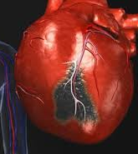
Heart Diseases
There are numerous heart deseases that includes (Litviňuková et al 2020).
Coronary artery disease
Unstable Enigma Pectoris.
Heart attack.
Congestive heart failure
Cardiomyopathy
Myocarditis
Pericarditis
Atrial fibrillation
Cardiac arrest

Slide 11

Thank You

Slide 12

References
.
Anatomy of the Human Heart. (2020, August 4). Physiopedia, . Retrieved 09:39, December 10, 2020 from https://www.physio-pedia.com/index.php?title=Anatomy_of_the_Human_Heart&oldid=245350.
Hoffman,, M. D. (2009, June 30). The heart (Human anatomy): Picture, definition, location in the body, and heart problems. WebMD. https://www.webmd.com/heart/picture-of-the-heart#1
Litviňuková, M., Talavera-López, C., Maatz, H., Reichart, D., Worth, C. L., Lindberg, E. L., ... & Nadelmann, E. R. (2020). Cells of the adult human heart. Nature, 1-10.
Morita, H., Seidman, J., & Seidman, C. E. (2005). Genetic causes of human heart failure. The Journal of clinical investigation, 115(3), 518-526.
Newman, T. (2020). The heart: Anatomy, physiology, and function. Medical and health information. https://www.medicalnewstoday.com/articles/320565

